Slide 1
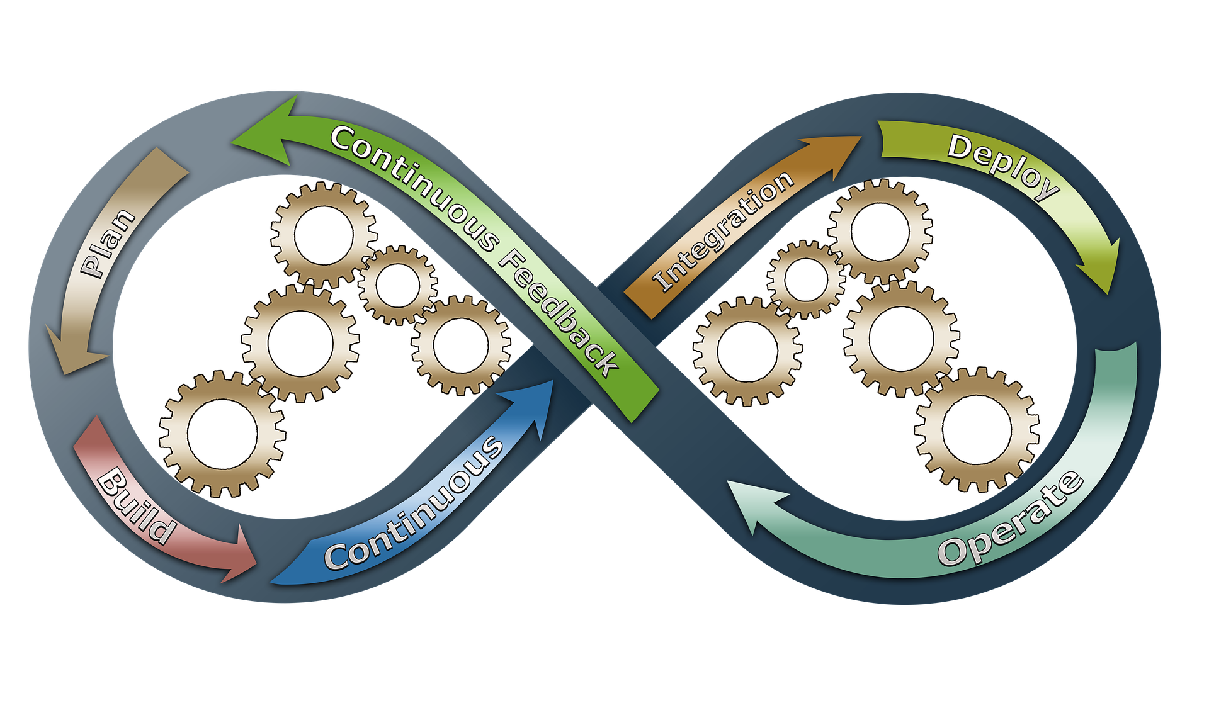
The Agile Approach
by Sam Maclean

Slide 2
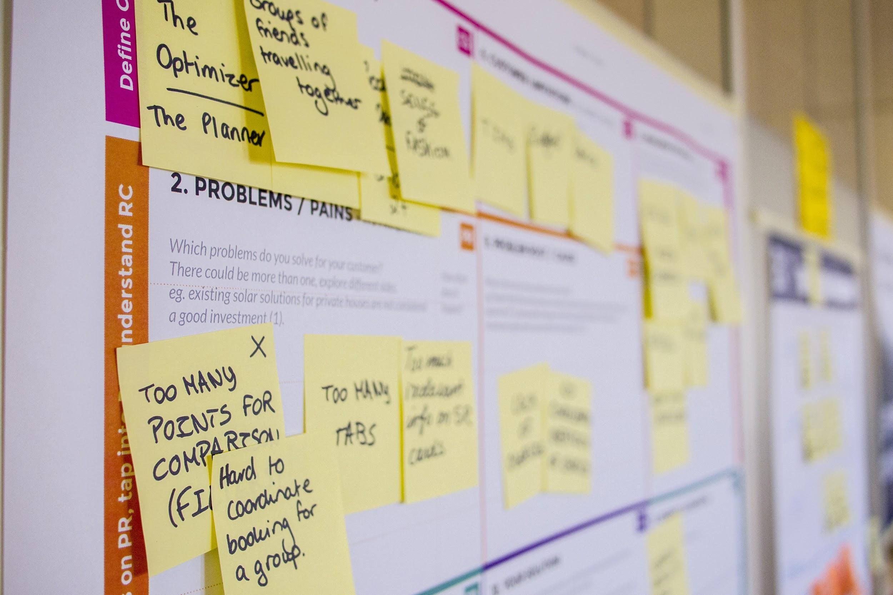
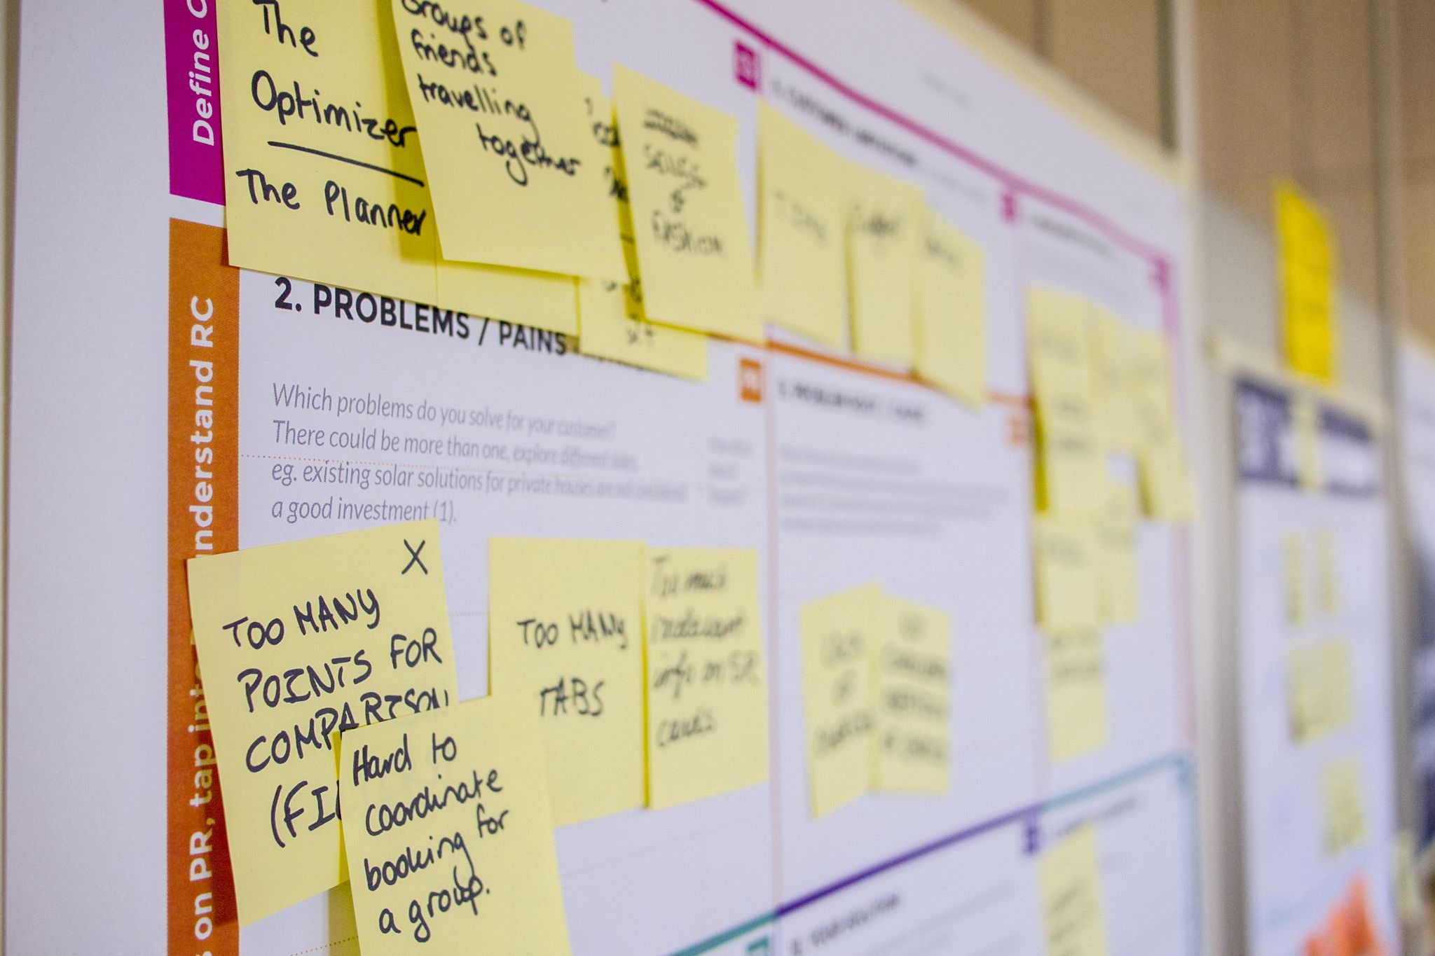
Characteristics of Agile
The agile approach to the Software Development Lifecycle (SDLC) allows for extensive flexibility and carries many more benefits than the waterfall approach
Continuous development/testing
Team members have specific roles with specific duties assigned to them
Extensive communication
Scrum events take place regularly

Slide 3
Roles of Agile
Scrum Master
Leads and organizes scrum meetings by setting a specific time frame
Oversees and manages the team while keeping them on task
Manages any issues among the scrum team (Goodpasture, 324)
Developer/Tester
Consistent testing throughout development cycle
Ensure product quality and communicate any potential issues
Uses proper estimation techniques and reporting findings
Product Owner
Manages product backlog (Cobb, 35)
Effectively communicates with team members and stakeholders
Manages any changes to the development of the product
Describes the vision for the product to ensure the team understands what the general goal is in the development of the product
Stakeholders/Users
Users give user stories to help the development of the project and spark new ideas
Stakeholders meet with agile team regularly
Stakeholders invest in product and share their thoughts on the product
Both influence the products outcome

Slide 4
Phases of the SDLC Through Agile
Planning ahead - In an agile approach, the product owner will define the vision for the product in this state and the team will discuss the outlook of the project.
Gather Resources - Here is where any materials or key members of the project will be defined. Potential stakeholders and users will be taken into consideration.
Design - During this stage, the agile team will come up with a general blueprint for what the project should look like. This is important in helping further identify the vision for the product.
Development - Product development takes place as the team uses scrum events to provide updates. User stories come in handy here as they are taken into consideration to maximize user friendliness.
Testing - Product is tested in various ways to ensure readability, identify errors, and make sure requirements for the product are met.
Deployment - Product is released to the public. In the agile environment, there will be room for additional testing as new errors are encountered. This is where the team will get an idea of how the users and stakeholders respond to the new product.
Maintenance - The final stage of the SDLC includes the sprint retrospective where the scrum team analyzes what went right and what went wrong for the project which will improve future projects.

Slide 5

Agile Versus Waterfall
The SNHU Travel project turned out successful largely due to the agile approach that was used which allowed for clear communication and consistent progress. If a waterfall approach was used instead, the team would have run into some problems:
Small teams tackling a series of small projects in agile lead to high quality performance (Goodpasture, 193) while waterfall focuses on one project at a time with a specific end goal.
Waterfall does not leave as much room for changes or improvements since testing is not done until a later stage while agile allows for continuous testing for consistent flexibility. The lack of flexibility would not have allowed for abrupt changes such as the focus on detox and wellness vacations rather than general vacations.
There is a lack of communication within the waterfall approach among team members and stakeholders while agile emphasizes consistent communication among all roles of the products development. This allowed us to hear user stories that gave us the information we needed to find out what the user wants to see which would not have occurred with the waterfall approach.

Slide 6
Is Agile or Waterfall a Better Fit?
When choosing between the agile or waterfall approach, it is important to consider the needs for the product and the deadline. If the there is a clear vision of the end-goal of the product and a specified deadline, a waterfall might be a better approach to accomplish the task. If the project is not completely defined and has room for changes, agile will provide flexibility for those changes and allow for a non-specific deadline which will increase quality and reduce stress. Large groups tackling large projects are common in waterfall while smaller groups tackling small projects work better for the agile approach. Agile has been commonly known to be more effective overall but waterfall may work better for specific scenarios. If you feel like your team has lacked communication in past projects and has struggled to improve, agile might be a good opportunity to try out since it emphasizes communication and consistent progress.

Slide 7
References
John Goodpasture. (2016). Project Management the Agile Way, Second Edition : Making It Work in the Enterprise: Vol. Second edition. J. Ross Publishing.
Charles G. Cobb. (2015). The Project Manager’s Guide to Mastering Agile : Principles and Practices for an Adaptive Approach. Wiley.

